Slide 1
Simple notification service (SNS)
Velocity training institute
Shantanu Mahajan (sr engg devops)

Slide 2
SNS
Amazon Simple Notification Service (Amazon SNS) is a fully managed messaging service for both application-to-application (A2A) and application-to-person (A2P) communication.
SNS is a fast, flexible, fully managed notification service, provided by amazon.
It delivers the messaged to the subscripting endpoints such as emails, SMS, devices, other AWS services.
We can send individual messages or fan out messages to large number of recipients.
When a topic is created, Amazon SNS will assign a unique ARN (Amazon Resource Name) to the topic, which will include the service name (SNS), region, AWS ID of the user and the topic name.
This is a region specific service

Slide 3
benefits
Inexpensive
Pay as you go.
Reliable
Instantaneous, push-based delivery.
Web-based AWS Management Console offers the simplicity of a point-and-click interface.

Slide 4
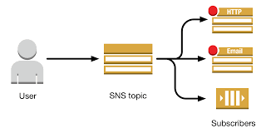
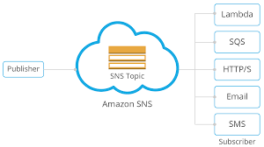
SNS topic
An Amazon SNS topic is a logical access point that acts as a communication channel.
When publishers have information or updates to notify their subscribers about, they can publish a message to the topic – which immediately triggers Amazon SNS to deliver the message to all applicable subscribers.

Slide 5
SNS Supported Transport Protocols
HTTP, HTTPS – Subscribers specify a URL as part of the subscription registration; notifications will be delivered through an HTTP POST to the specified URL.
Email, Email-JSON – Messages are sent to registered addresses as email. Email-JSON sends notifications as a JSON object, while Email sends text-based email.
SQS – Users can specify an SQS queue as the endpoint; SNS will enqueue a notification message to the specified queue (which subscribers can then process using SQS APIs such as ReceiveMessage, DeleteMessage, etc.)
SMS – Messages are sent to registered phone numbers as SMS text messages

Slide 6
SNS Supported Endpoints
Email Notifications
SNS provides the ability to send Email notifications
Mobile Push Notifications
SNS provides an ability to send push notification messages directly to apps on mobile devices. Push notification messages sent to a mobile endpoint can appear in the mobile app as message alerts, badge updates, or even sound alerts
Supported push notification services
Amazon Device Messaging (ADM)
Apple Push Notification Service (APNS)
Google Cloud Messaging (GCM)
Windows Push Notification Service (WNS) for Windows 8+ and Windows Phone 8.1+
Microsoft Push Notification Service (MPNS) for Windows Phone 7+
Baidu Cloud Push for Android devices in China

Slide 7
SNS Supported Endpoints
SMS Notifications
HTTP/HTTPS Endpoints
SNS provides the ability to send notification messages to one or more HTTP or HTTPS endpoints, with the help of POST method.
Etc ….

Slide 8
Pricing
https://aws.amazon.com/sns/pricing/

